Slide 1
Levi Strauss & Company Assignment
By: Kritika Tagare

Slide 2
Work- Flow
Define Problem
Data Collection
Feature Selection
Feature Analysis
Exploratory Data Analysis

Slide 3
Problem Statement
With growing demands and cut-throat competitions in the market, a Superstore Giant is seeking your knowledge in understanding what works best for them. They would like to understand which products, regions, categories and customer segments they should target or avoid.

Slide 4
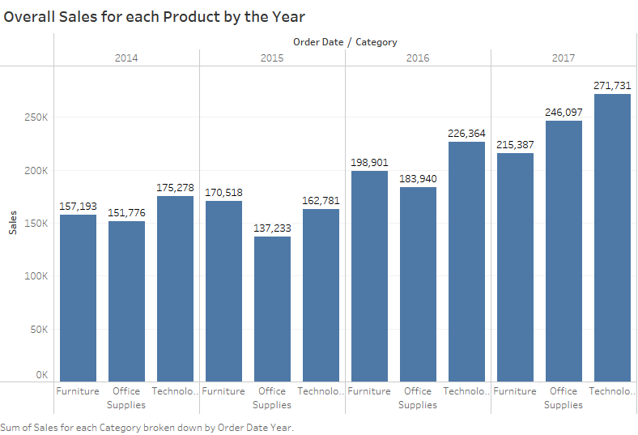
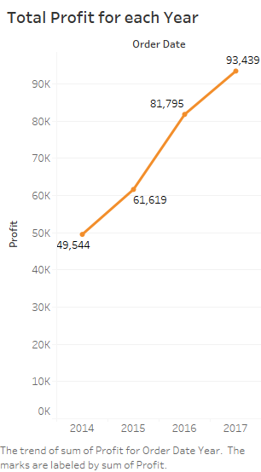
Sales & Profit Observation Through this visualization we can see that sales as well as profit has increased year by year

Slide 5
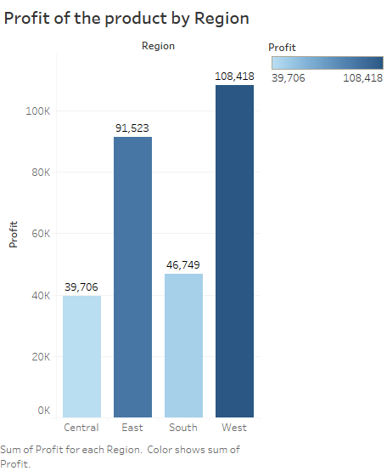
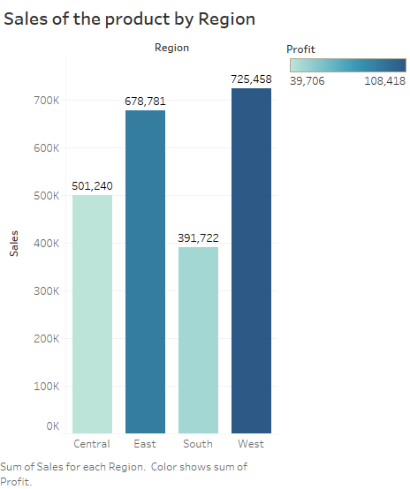
Observation by Region
Here we can see that west region has maximum number of sales & more profits also

Slide 6
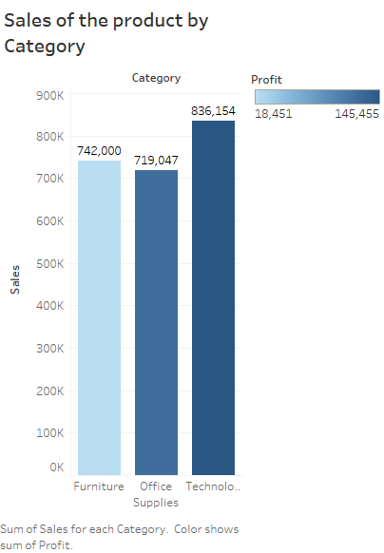
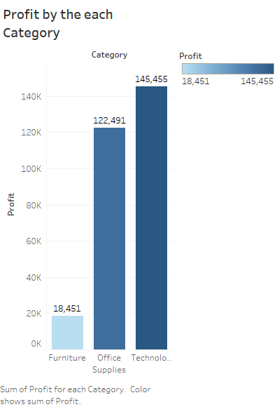
Observation by Category
Here we can see that Technology Category has maximum number of sales & more
profits also

Slide 7
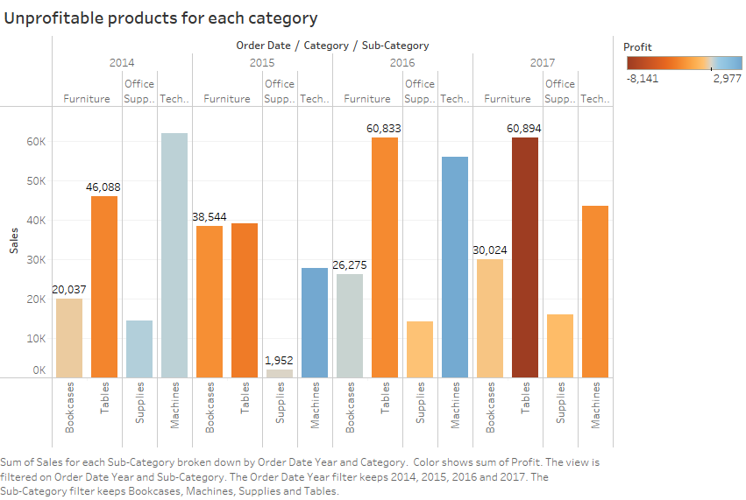
Product Observation

Slide 8
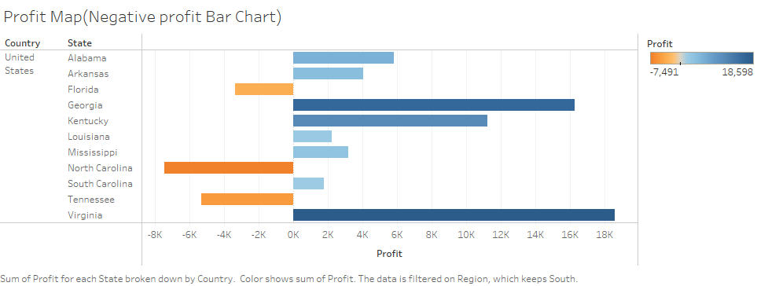
Loss Observation
As per the Graph visualization the states in orange color have losses.

Slide 9
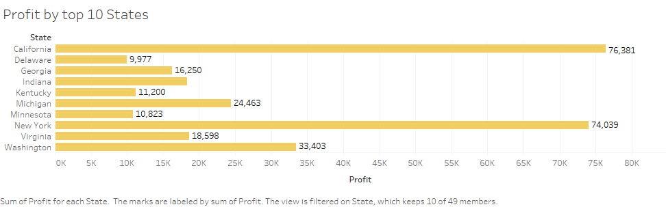
Profit Observation
As per the Graph visualization California is having maximum profit.

Slide 10
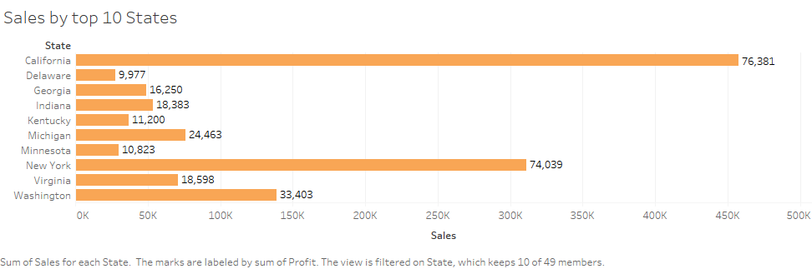
Sales Observation by top 10 States

Slide 11
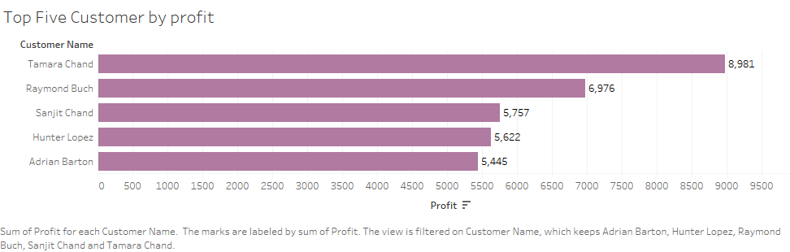
Customer Observation
Following are top five customers in terms of profit earnings.

Slide 12
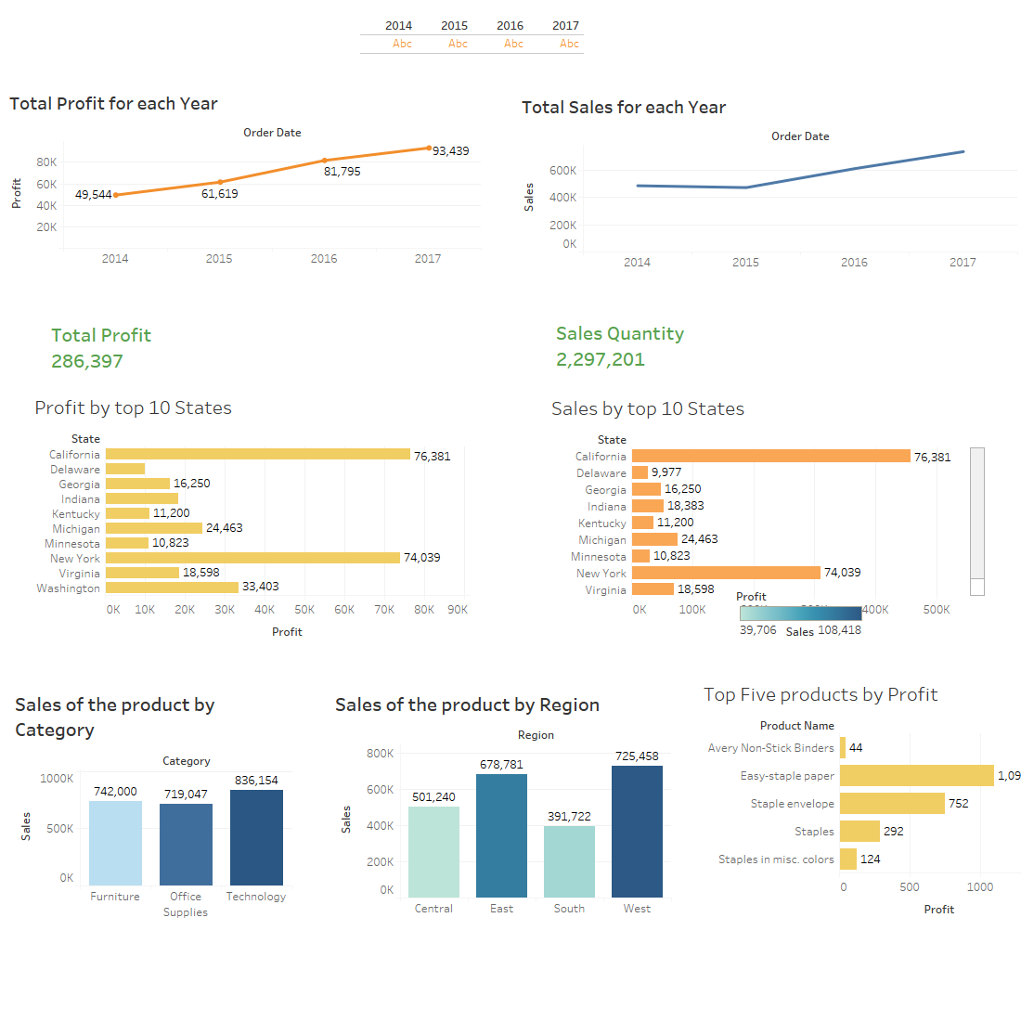
Dashboard

Slide 13
EDA Insights
The dataset is very imbalanced.
Copiers made most profit in all regions.
Technology made way more profit than other categories.
Most sales were made with no discount.
Even though discount was more, it didn't affect the number of sales.
Most number of sales in west region.
Most profit made in West region.
William Brown is the most loyal customer.
Most number of sales were made in New York City.
Most number of sales were made in California State.

Slide 14
Thank You

